Slide 1
LOOPS AND FUNCTIONS IN R
instructor: alfredo Ascanio
Assistant instructors: Luis M. Montilla & Hank Stevens

Slide 2
LOGISTICS
Breaks:
We will have two 10-min breaks within each day of class.
Questions:
Please post any question you have on the chat. We will try to address them as soon as possible.
We will also have a Q&A section by the end of the second day.
Break-out Rooms:
If you are really stuck, you can move to a break-out room with an Assistant Instructor to share your screen and get you up to speed.
Write to the assistant instructors and I’ll move you to that break-out room.
You can do this at any time, but the breaks may be a good opportunity for this.
Notes:
These are our goals for this course. It’s intended to be an introduction to how loops and functions work. We wish for you to be able to start building your own functions and loops whenever you need them, to facilitate your work as you advance in the world of computational biology. First, we will study the use of loops and conditional statements. Why should we use them, how are they structured and how can we stop them or put conditions on their execution..
The second day, we will study how to create functions on our own, and how to integrate loops within functions.

Slide 3
GOALS
Understand and use conditional logic (Monday)
Conditional statements
Understand and make your first loop (Monday)
Structure of loops (mainly for-loop)
Quick review on while-loop and repeat-loop
Uses
Making your own functions (Tuesday)
Input and Output
Arguments/Parameters
Default values
Notes:
These are our goals for this course. It’s intended to be an introduction to how loops and functions work. We wish for you to be able to start building your own functions and loops whenever you need them, to facilitate your work as you advance in the world of computational biology. First, we will study the use of loops and conditional statements. Why should we use them, how are they structured and how can we stop them or put conditions on their execution..
The second day, we will study how to create functions on our own, and how to integrate loops within functions.

Slide 4
RECOMMENDED PREVIOUS KNOWLEDGE
Data types in R or Python: numeric, character, factors, logical values, etc.
Base R or Python objects:
Vectors, Matrices, Lists, and Data Frames
Subsetting
Using functions
Conditionals and Logical Operators
WE WILL REVIEW SOME OF THESE CONTENTS BRIEFLY
BUT PREVIOUS KNOWLEDGE IS RECOMMENDED BEFORE TAKING THIS COURSE

Slide 5
DATA
Randomly generated data for initial and basic examples:
Coin tossing simulation
Bifurcating maze
Ecological data and maps for real-world applications:
Burmese python (Python bivittatus) occurrences from GBIF
Manatee (Trichechus manatus) occurrences from GBIF
Notes:
We will use randomly generated data along with real datasets to earn some experience in real-world applications of loops and functions.

Slide 6
WHY LOOPS AND FUNCTIONS?
“If you need to repeat a process more than twice, program it”
Loops will help us repeat a process multiple times, e.g. on different datasets (or subsets of them) considering that their format remains the same.
Sequence i = 1 to N
Input Data
Process
Data(i)
After i = N
Stop
Notes:
While doing your work, have you found yourselves doing the same steps multiple times on different subsets of your data, or in multiple datasets with similar formats?
That’s why understanding how to built loops and functions is important. Some of the advantages of coding your processes in this way are:
Not having to make everything by hand
It takes time at first, but it will save a lot of time later
Shareability
Transparency
Ability to retrace your steps in the process and make corrections or updates

Slide 7
WHY LOOPS AND FUNCTIONS?
“If you need to repeat a process more than twice, program it”
Functions will help us simplify those processes, that tend to be comprised by multiple and sometimes complex steps, into a couple lines of code.
Input Data
Process/Step 1
Process/Step 2
Output
Input Data
Function
Output
Notes:
While doing your work, have you found yourselves doing the same steps multiple times on different subsets of your data, or in multiple datasets with similar formats?
That’s why understanding how to built loops and functions is important. Some of the advantages of coding your processes in this way are:
Not having to make everything by hand
It takes time at first, but it will save a lot of time later
Shareability
Transparency
Ability to retrace your steps in the process and make corrections or updates

Slide 8
CONDITIONALS

Slide 9

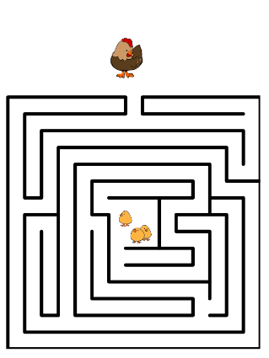

CONDITIONALS: IF-ELSE
Decisions accounted for during a process
Examples:
Games: If the coin turns head then I win, otherwise (else) I lose
Finding a path in a maze: If the path on the right is open, then I will go through it, otherwise (else) I will go left.
Life decisions: If the food smells good, then I will eat it, otherwise (else) I will not.
Notes:
One important element within loops and functions are the conditional statements. These statements, usually called “conditionals”, can help us integrate decisions into the processes that we are using or building.

Slide 10
CONDITIONALS: IF-ELSE
HOW DO WE WRITE A CONDITIONAL IN R?
1) First, let’s create an R project in Rstudio
2) Put the CONDITIONAL.R script in your flash drive, on Project Folder.
3) Open the R script
4) Let’s make a game! – Coin Tossing Game
Random game, with binomial probability of success
If the coin falls as I wanted to --- MUST BE A LOGICAL CONDITION (TRUE/FALSE)
Then I win --- PROCESS TO OCCUR IF CONDITION WAS TRUE
Else I lose --- OPTIONAL PROCESS TO OCCUR IF CONDITION WAS FALSE

Slide 11
CONDITIONALS: IF-ELSE
Let’s make a game! – Coin Tossing Game
Random game, with binomial probability of success
If the coin falls as I wanted to --- MUST BE A LOGICAL CONDITION (TRUE/FALSE)
Then I won --- PROCESS TO OCCUR IF CONDITION IS TRUE
Else I lose --- OPTIONAL PROCESS TO OCCUR IF CONDITION WAS FALSE
> coin_toss <- rbinom(n = 1, size = 1, prob = 0.5)
# Simulates a coin toss, with 0.5 probability of success
# Results will be 0 (failure) or 1 (success) following a binomial probability
> if(coin_toss == 1) { print(“You win”) }
# if condition within () results to TRUE --- then process within {} will run
> } else { print(“You Lose”)} # only if the condition within () results to FALSE

Slide 12
CONDITIONALS: IF-ELSE
Let’s make a game! – Coin Tossing Game
In summary
# Simulate a coin toss
> coin_toss <- rbinom(n = 1, size = 1, prob = 0.5)
# Set condition for success, define process to occur if conditions
# are TRUE or FALSE and corresponding outputs
if(coin_toss == 1) { print(“You win”)
} else { print(“You Lose”)}

Slide 13
CONDITIONALS: IF-ELSE
Let’s make a game! – Coin Tossing Game
Exercise 1: What if we want the output to be Head or Tails, instead of winning or losing? What if the coin is rigged, favoring heads over tails? Change the code to make it happen
# Simulate a coin toss
> coin_toss <- rbinom(n = 1, size = 1, prob = _____)
# Set condition for success, define process to occur if conditions
# are TRUE or FALSE and corresponding outputs
if(coin_toss == 1) { print(“______”)
} else { print(“______”)}

Slide 14
CONDITIONALS: IF-ELSE
Extensions to the If-Else logic
The process within a conditional statement will run if and only if the condition results to TRUE (a logical value in R)
If the condition within the if() function results to FALSE, then the secondary and optional process will run instead.
We can add as many conditions as we need
> if(TRUE) { print(“Execute process 1!”)
} else { print(“Execute process 2!”)}
> if(condition_1 == TRUE) { print(“Execute process 1!”)
} else if(condition_2 == TRUE) { print(“Execute process 2!”)
} else {print(“Final process if everything else fails”}

Slide 15
CONDITIONALS: IF-ELSE
Logical operators
Conditionals depend on how we create a logical vector of length one.
We can see this as asking the computer a question, which answer can only be TRUE or FALSE
> x <- 5; y <- 8
> x > y #is x greater than y? Results to FALSE
> x < y #is x less than y? Results to TRUE
> x >= y #is x equal to or greater than y? Results to FALSE
> x <= y #is x equal to or less than y? Results to TRUE
> x == y #is x equal to y? Results to FALSE
> x != y #is x different to y? Results to TRUE
> X %in% y #is the value of x contained in the values of y? Results FALSE

Slide 16
CONDITIONALS: IF-ELSE
Logical operators and functions with logical outputs
These logical operators work with different types of data, e.g. comparing strings of characters, factors, dates, etc.
There are functions that result in logical TRUE/FALSE values
> indetical(x, y) #if two objects are exactly the same returns one TRUE
> any() #Input is a logical vector, if any value is TRUE, returns one TRUE
> all() # input is a logical vector, if all values are TRUE, returns one TRUE
> is.() #Family of functions
> is.numeric() # if vector or matrix is numeric, returns TRUE
> is.integer() # if vector or matrix is integer, returns TRUE
> is.vector() # if object is vector, returns TRUE, etc…
#There are many more that you will discover as you start needing them

Slide 17
CONDITIONALS: IF-ELSE
Let’s choose a path! – Choose Left or Right
Exercise 2: Imagine a maze that, each time you give a step, bifurcates in two paths, one closed and one open. I want you to determine whether you should go left or right depending on where you are in the maze.
I provided you with a function to create a random maze. It has two outputs:
1) the maze plot
2) a data frame that we can call our “maze object”
Run the function and explore the maze object and the plot: what question should you ask to your computer to make the decision to move forward?

Slide 18
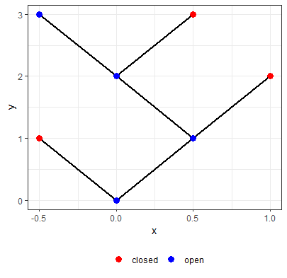
CONDITIONALS: IF-ELSE
Let’s choose a path! – Choose Left or Right
Exercise 2: Store the output of the function make_maze() in an object called “Maze”

Slide 19
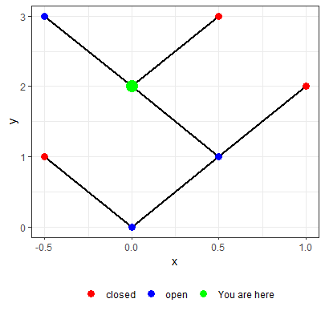
CONDITIONALS: IF-ELSE
Let’s choose a path! – Choose Left or Right
Exercise 2: Run the function where_are_you() on the object “Maze”. Store the output
Store this output in the object “where_at”, and:
Construct a conditional, which output should be
“Left” or “Right”
Depending on where you are and the next open path

Slide 20
CONDITIONALS: IF-ELSE
Let’s choose a path! – Choose Left or Right
Exercise 2: Create the corresponding conditional
Hints: Think of a way to identify whether the open path (blue) is to the “Left” or “Right” of the closed path (red).
Which variable in the output table gives you that information?

Slide 21
CONDITIONALS: IF-ELSE
Let’s choose a path! – Choose Left or Right
Exercise 2: Write the conditional logic in words
Conditional:
If the value of X where the path is open is lower than the value of X where the path is closed, then the solution should be “Right”, otherwise the solution should be “Left”
Hints: Think of a way to identify whether the open path (blue) is to the “Left” or “Right” of the closed path (red).
Which variable in the output table gives you that information?

Slide 22
CONDITIONALS: IF-ELSE
Let’s choose a path! – Choose Left or Right
Exercise 2: Write the conditional logic in code and print the output
Conditional:
> if(where_at$x[where_at$open == 1] > where_at$x[where_at$open == 0]) {
print(“Right”) } else {
print(“Left”)
}
Hints: Think of a way to identify whether the open path (blue) is to the “Left” or “Right” of the closed path (red).
Which variable in the output table gives you that information?

Slide 23
CONDITIONALS: IF-ELSE
Let’s choose a path! – Choose Left or Right
Exercise 2: Write the conditional logic in code and print the output
Conditional:
> if(where_at$x[where_at$open == 1] > where_at$x[where_at$open == 0]) {
print(“Right”) } else {
print(“Left”)
}
> “Left”

Slide 24
10 Minutes Break
Congratulations!
You built your first conditional statements!

Slide 25
LOOPS

Slide 26
LOOPS: FOR
Repeat a process iteratively N times
What’s a for-loop?
It’s a way of repeating a process a set number of times
What’s an iteration?
The number of times or cycles the loop will execute its internal process
Sequence i = 1 to N
Input Data
Process
Data(i)
After i = N
Stop

Slide 27
LOOPS: FOR
Repeat a process iteratively N times
Iterations in a for-loop
The number of iterations is predetermined since the beginning.
You need to provide an iterative term and a vector as input
Internally, the value of the iterative term will change at each new cycle of the loop, sequentially assigning it the values of the input vector.
The vector could be of any data type

Slide 28
LOOPS: FOR
Repeat a process iteratively N times
Structure of a for-loop
for statement
Iterative term
Vector or sequence
Process
> for(i in 1:10) {
print(i)
}
# for() is the function that will initialize the loop
# i is the iterative term
# 1:10 is a numeric vector from 1 to 10
# print(i) is the process
# the loop stops when the iterative term (i) reaches the last element of the vector, i.e. 10.
Quick Exercise: Change the input vector and the name of the iterative term
a) You can add a mathematical operation to the process (if vector is numeric)
b) You can make the vector a character vector. See what happens.

Slide 29
LOOPS: FOR
Identifying the proper iterative term
Iterative terms and sequence vectors
The proper use of these terms and vectors, will allow you to be more efficient each time you need to write a for-loop
It depends on:
1) The process you need to execute, and
2) The type of object you have
i1 | i2 | i3 | i4 | i5 | i6
i1 | i2 | i3 | i4 | i5 | i6
i1
i2
i3
i4
By vector
By Column
By Row

Slide 30
LOOPS: FOR
Identifying the proper iterative term
Iterative terms
The proper use of this term, will allow you to be more efficient each time you need to write a for-loop
It depends on:
1) The process you need to execute, and
2) The type of object you have
 |  |  | A
 |  |  | A
 |  |  | B
 |  |  | C
i = | 1 | 2 | 3 | 4 | 5
 |  |  | X
 |  |  | 12
 |  |  | 3
 |  |  | 8
By Condition (e.g. X < 5 * i)
By factor

Slide 31
LOOPS: FOR
Let’s find the exit of the Maze!
Exercise 3: Using the same functions as in exercise 2, create a maze and using a for-loop find the solution of the maze
This loop should run as many times as steps the maze has
Use the logic of the conditional we built before
The output should be a sequence of “Left” and “Right” values that allows you to reach the goal

Slide 32
LOOPS: FOR
Let’s find the exit of the Maze!
Exercise 3: Using the same functions as in exercise 2, create a maze and using a for-loop find the solution of the maze
1) Identify a iterative term and sequence vector
2) Define the process you need to make at each change of the iterative term
3) Construct the loop

Slide 33
LOOPS: FOR
Let’s find the exit of the Maze!
1) Identify a iterative term and sequence vector | 2) Define the process you need to make
3) Construct the loop

Slide 34
LOOPS: FOR
Let’s find the exit of the Maze!
1) Identify the iterative term and sequence vector | 2) Define the process you need to make
3) Construct the loop
Coding the sequence vector for iterative term
# Values from 1 to 3 (only applicable to a 3 step maze)
> 1:3
# Unique values of Y, except for the first one
> unique(Maze$y)[-1]
# Applicable to any maze with steps > 0

Slide 35
LOOPS: FOR
Let’s find the exit of the Maze!
1) Identify a iterative term and sequence vector | 2) Define the process you need to make
3) Construct the loop
Process:
Subset the rows for one iteration (e.g. Y = 1)
2) If the value of X where the path is open is lower than the value of X where the path is closed, then the solution should be “Right”, otherwise the solution should be “Left”

Slide 36
LOOPS: FOR
Let’s find the exit of the Maze!
1) Identify a iterative term and sequence vector | 2) Define the process you need to make
3) Construct the loop
Process:
# Subset rows where Y == 1
> where_at <- Maze[Maze$y == 1, ]
# Conditional
> if(where_at$x[where_at$open == 1] > where_at$x[where_at$open == 0]) {
print(“Right”) } else {
print(“Left”)
}

Slide 37
LOOPS: FOR
Let’s find the exit of the Maze!
1) Identify a iterative term and sequence vector | 2) Define the process you need to make
3) Construct the loop
For-Loop:
# Combine previous steps. Change 1 for the iterative term when appropiate
> for(i in unique(Maze$y)[-1]) {
where_at <- Maze[Maze$y == i,]
if(where_at$x[where_at$open == 1] > where_at$x[where_at$open == 0]) {
print(“Right”) } else {
print(“Left”)
}
}

Slide 38
LOOPS: FOR
Let’s join data from different sources!
Exercise 4: Using what you have learned and the functions I’ll provide to you, construct a loop to merge tables from different sources
Data: Occurrence data for one species
Sources: Different museums, online databases, etc.
In the process: Filter the data before merging it together
By year (after 1980)
By coordinate system (only WGS84)
Retain only columns: Species, Longitude, Latitude, Year and Coordinate System

Slide 39
LOOPS: FOR
Let’s join data from different sources!
Exercise 4: Using what you have learned and the functions I’ll provide to you, construct a loop to merge tables from different sources
Identify the iterative term and vector
Define the process
Construct the loop

Slide 40
LOOPS: FOR
Let’s join data from different sources!
Exercise 4: Using what you have learned and the functions I’ll provide to you, construct a loop to merge tables from different sources
Identify the iterative term and vector
One process per file to read
Iterative term could either be a number per file or a file name
Thus, the vector can be a numeric sequence from 1 to the number of files
Or the vector can be a character vector from file names
This decision will depend on the rest of the process and what is more useful to you.

Slide 41
LOOPS: FOR
Let’s join data from different sources!
Exercise 4: Using what you have learned and the functions I’ll provide to you, construct a loop to merge tables from different sources
Define the process
Read file
Filter file
Attach to previously read file
Implications: previously existent objects (can start as a NULL R object)

Slide 42
LOOPS: FOR
Let’s join data from different sources!
Exercise 4: Using what you have learned and the functions I’ll provide to you, construct a loop to merge tables from different sources
Construct the loop
Add for() statement
Add iterative term and vector
Add process
Close loop

Slide 43
LOOPS: FOR
Let’s join data from different sources!
Exercise 4: Using what you have learned and the functions I’ll provide to you, construct a loop to merge tables from different sources
My take on this exercise
> files <- list.files(“PATH_TO_FOLDER”) # Make list of files
> full_data <- NULL # Make empty object
> for(i in 1:length(files)) {
data <- read.csv(files[i], header = T, stringsAsFactors = F) # Read data
# Filter data
filtered_data <- data[data$year > 1970 & data$coord.sys == “WGS84”, ]
# Attach data
full_data <- rbind(full_data, filtered_data)
} # Close loopc

Slide 44
10 Minutes Break
Congratulations!
You built your first
FOR-LOOPS

Slide 45
LOOPS: WHILE
Repeat a process iteratively WHILE a condition is met
What’s a while-loop?
It’s a way of repeating a process while a condition is met
Process
Input Data
Condition
TRUE
Stop
FALSE

Slide 46
LOOPS: WHILE
Repeat a process iteratively WHILE a condition is met
What’s an iteration?
The number of times or cycles the loop will execute its internal process.
In a while loop, iterations can be infinite. In this sense, we must be careful not to create infinite loops.

Slide 47
LOOPS: WHILE
Example: Imagine we have a variable X = 1. While X remains less than 10, we will add 1 to it.
# Create X variable
> x <- 1
# While-loop
> while(x < 10) {
x = x + 1
print(x)
}

Slide 48
LOOPS: WHILE
Quick Exercise: Using the coin toss analogy, let’s start with a variable X = 1. Each time we flip a coin successfully (coin_toss == 1), we will sum a unit to X. This process will run while X remains less than or equal to 10
> coin_toss <- rbinom(n = 1, size = 1, prob = 0.5) # Remember the coin_toss
> x <- 1 # Create X variable
# While-loop
> while(x ______) { # Add a initial condition
________________ # Add a coin_toss
________________ # Add a conditional
________________ # Add a print of x
}
# In this case, there is no need to add an “else” statement, as nothing should happen to X if we fail the coin_toss

Slide 49
LOOPS: WHILE
Quick Exercise: Using the coin toss analogy, let’s start with a variable X = 1. Each time we flip a coin successfully (coin_toss == 1), we will sum a unit to X. This process will run while X remains less than or equal to 10
> coin_toss <- rbinom(n = 1, size = 1, prob = 0.5) # Remember the coin_toss
> x <- 1 # Create X variable
# While-loop
> while(x <= 10) { # Add a initial condition
coin_toss <- rbinom(n = 1, size = 1, prob = 0.5) # Add a coin_toss
if(coin_toss == 1) { x <- x + 1 } # Add a conditional
print(x) # Add a print of x
}
# In this case, there is no need to add an “else” statement, as nothing should happen to X if we fail the coin_toss

Slide 50
LOOPS: REPEAT
Repeat a process iteratively UNTIL a condition is met
What’s a repeat-loop?
It’s a way of repeating a process until a condition is met
Condition
FALSE
Input Data
Process
TRUE
Stop

Slide 51
LOOPS: REPEAT
Repeat a process iteratively UNTIL a condition is met
What’s an iteration?
The number of times or cycles the loop will execute its internal process.
In a repeat loop, iterations can be infinite. In this sense, we must be careful not to create infinite loops.

Slide 52
LOOPS: REPEAT
Example: Imagine we have a variable X = 1. Until X reaches 10, we will add 1 to it.
# Create X variable
> x <- 1
# Repeat-loop
> repeat {
x = x + 1
print(x)
if(x == 10) {break()}
}
# We use the function break() after a conditional to stop the loop

Slide 53
LOOPS: REPEAT
Quick Exercise: Using the coin toss analogy, let’s start with a variable X = 1. Each time we flip a coin successfully (coin_toss == 1), we will add a unit to X. This process will run until X reaches 10
> coin_toss <- rbinom(n = 1, size = 1, prob = 0.5) # Remember the coin_toss
> x <- 1 # Create X variable
# repeat-loop
> repeat {
________________ # Add a coin_toss
________________ # Add a conditional
________________ # Add a print of x
________________ # Add breaking condition of x
}
# In this case, there is no need to add an “else” statement, as nothing should happen to X if we fail the coin_toss

Slide 54
LOOPS: REPEAT
Quick Exercise: Using the coin toss analogy, let’s start with a variable X = 1. Each time we flip a coin successfully (coin_toss == 1), we will add a unit to X. This process will run until X reaches 10
> coin_toss <- rbinom(n = 1, size = 1, prob = 0.5) # Remember the coin_toss
> x <- 1 # Create X variable
# repeat-loop
> repeat {
coin_toss <- rbinom(n = 1, size = 1, prob = 0.5) # Add a coin_toss
if(coin_toss == 1) { x <- x + 1 } # Add a conditional
print(x) # Add a print of x
if(x == 10) { break() } # Add breaking condition of x
}
# In this case, there is no need to add an “else” statement, as nothing should happen to X if we fail the coin_toss

Slide 55
FUNCTIONS

Slide 56
FUNCTIONS
Functions will help us simplify processes, that tend to be comprised by multiple and sometimes complex steps, into a couple lines of code.
Input Data
Process/Step 1
Process/Step 2
Output
Input Data
Function
Output

Slide 57
FUNCTIONS
Functions will help us simplify processes, that tend to be comprised by multiple and sometimes complex steps, into a couple lines of code.
Structure of a function:
Input: The information or data we start with
Process: The different steps of cleaning, analyses, mathematical operations, etc., that we want to occur over our data. Loops are processes themselves, so you can put a loop within a function.
Output: The expected result of the process. Can be a new table, summary statistics, analysis results, plots, and more.

Slide 58
FUNCTIONS
Structure of a function in R:
Name: The name of the function, that you’ll be able to use as any normal function in R.
function() statement: this statement contains our arguments. These are the names of objects or variables that will play a role in the function internal process, and must be provided by the user of the function.
Some arguments can have default values
Internal process: within a pair of curly brackets after the function statement. We will list all the steps and sub-processes over the input.
Output: As part of the internal process, we must make sure to have an output; often times using the return() function.

Slide 59
FUNCTIONS
Example of a Function: sample()
The name of this function is “sample”
Go to the help of the function in R
What are the arguments of this function?
Are there default values?
View or print the function
What is the internal process of this function?
You don’t have to understand all the internal process, but this is a good way to become comfortable reading code from other sources aside from the one you have written yourself.

Slide 60
FUNCTIONS
Let’s write our first function!
We are going to make two numbers multiply each other using a function. R has its own multiplication operator (*), however, our goal is to get you used to the structure of a function in R.
Input: arguments X and Y, both numbers
Process: Multiply X*Y, assign the result to a new object Z
Output: return Z
> Multiplication <- function(X, Y) { # name, function statements, and arguments
# Internal process
Z = X*Y
return(Z)
}

Slide 61
FUNCTIONS
Let’s write our first function!
We are going to make two numbers multiply each other using a function. R has its own multiplication operator (*), however, our goal is to get you used to the structure of a function in R.
Input: arguments X and Y, both numbers
Process: Multiply X*Y, assign the result to a new object Z
Output: return Z
> Multiplication(X = 3, Y = 8) # Results in 24
> Multiplication(2, 9) # Results in 18
> Multiplication() # Results in Error, as there were no default values

Slide 62
FUNCTIONS
Let’s write our first function!
Let’s use the same function, but adding some default values
Input: arguments X = 1 and Y = 7, both numbers
Process: Multiply X*Y, assign the result to a new object Z
Output: return Z
> Multiplication <- function(X = 1, Y = 7) { # name, function statements, and arguments
# Internal process
Z = X*Y
return(Z)
}

Slide 63
FUNCTIONS
Let’s write our first function!
Let’s use the same function, but adding some default values
Input: arguments X = 1 and Y = 7, both numbers
Process: Multiply X*Y, assign the result to a new object Z
Output: return Z
Think about these results for a minute. What is happening with this function?
> Multiplication() # Results in 7
> Multiplication(X = 3, Y = 8) # Results in 24
> Multiplication(9) # Results in 63
> Multiplication(Y = 9) # Results in 9
> Multiplication(Y = 3, X = 4) # Results in 12

Slide 64
FUNCTIONS
Some Rules of Functions
Functions respect the order of the arguments.
You may put the name of the argument you want to use with the value/object you need it to be.
If you put the input values in order, you may omit the writing of the arguments’ names.
However, whenever you want to change the order of those arguments, or only refer to one of them that’s not the first argument, you must write its name and value.
All other unwritten arguments with default values will be kept as they are in the function definition.

Slide 65
FUNCTIONS
Quick Exercise: Create a function called “power_of”, that will raise one number to the power of a second number (X^{Y}). Set default values in a way that, whenever the second number Y is not provided, the result of power_of(X) will be 1, for any value of X.

Slide 66
FUNCTIONS
Quick Exercise: Create a function called “power_of”, that will raise one number to the power of a second number (X^{Y}). Set default values in a way that, whenever the second number Y is not provided, the result of power_of(X) will be 1, for any value of X.
> power_of <- function(X = 1, Y = 0) { # name, function statements, and arguments
# Internal process
Z = X^Y
return(Z)
}

Slide 67
FUNCTIONS
Let’s solve any Maze!
Exercise 5: Build a function around your previous loop to solve the maze, that works on any Maze object.

Slide 68
FUNCTIONS
Let’s solve any Maze!
Exercise 5: Build a function around your previous loop to solve the maze, that works on any Maze object.
Input: Maze data frame
Process: Your previous loop
Output: Can be the print the loop makes
Output (optional): store the solution in
a vector, and return that vector.

Slide 69
FUNCTIONS
Let’s solve any Maze!
Exercise 5: Build a function around your previous loop to solve the maze, that works on any Maze object.
> solve_maze <- function(Maze) {
for(i in unique(Maze$y)[-1]) {
where_at <- Maze[Maze$y == i,]
if(where_at$x[where_at$open == 1] > where_at$x[where_at$open == 0]) {
print(“Right”) } else {
print(“Left”)
}
}
}

Slide 70
10 Minutes Break
Congratulations!
You built your first
FUNCTIONS!

Slide 71
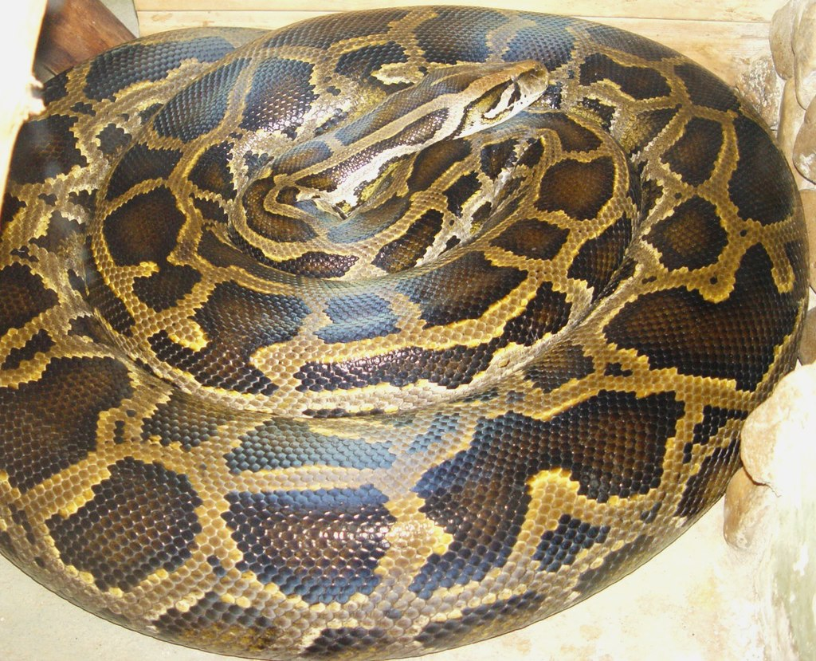
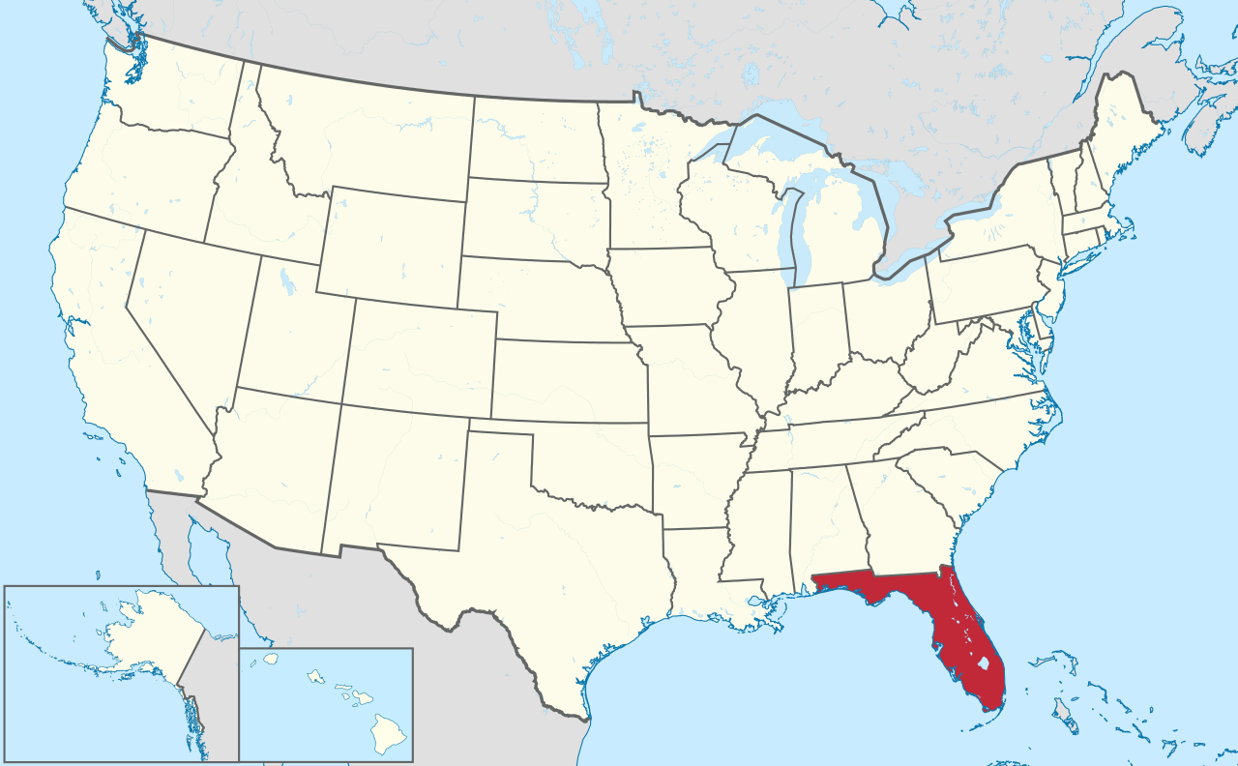
FUNCTIONS
Final Exercise: Create a function that makes occurrences map for Python bivittatus in the state of Florida

Slide 72
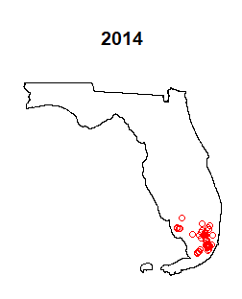
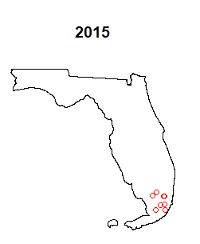
FUNCTIONS
Final Exercise: Create a function that makes occurrences map for Python bivittatus in the state of Florida
Input: Occurrence data frame, and Shapefile of Florida
Process: Cleaning, transforming, and plotting the data
Output: Map of occurrences for P. bivittatus in Florida
Conditions: Create the maps from 1991 to 2020
The functions you’ll need for the process are in the R script and
in the guide

Slide 73
10 Minutes Break
Congratulations!
You built your first
FUNCTIONS!

Slide 74
Q&A Section
Feel free to ask anything related to conditionals, loops, and functions in r

